Slide 1
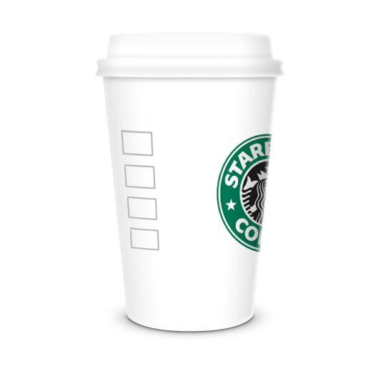
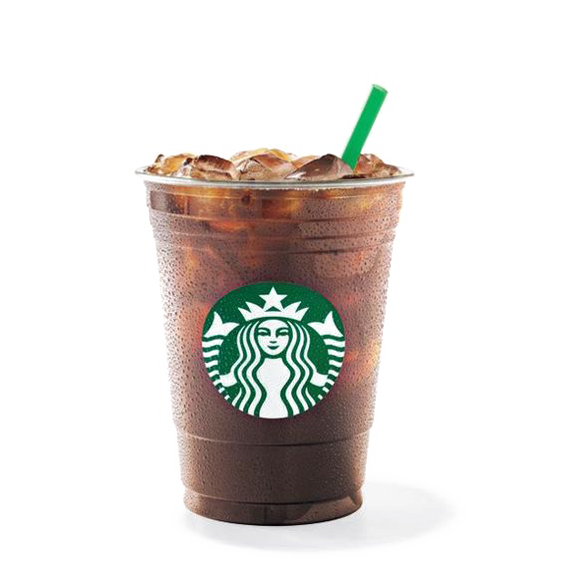
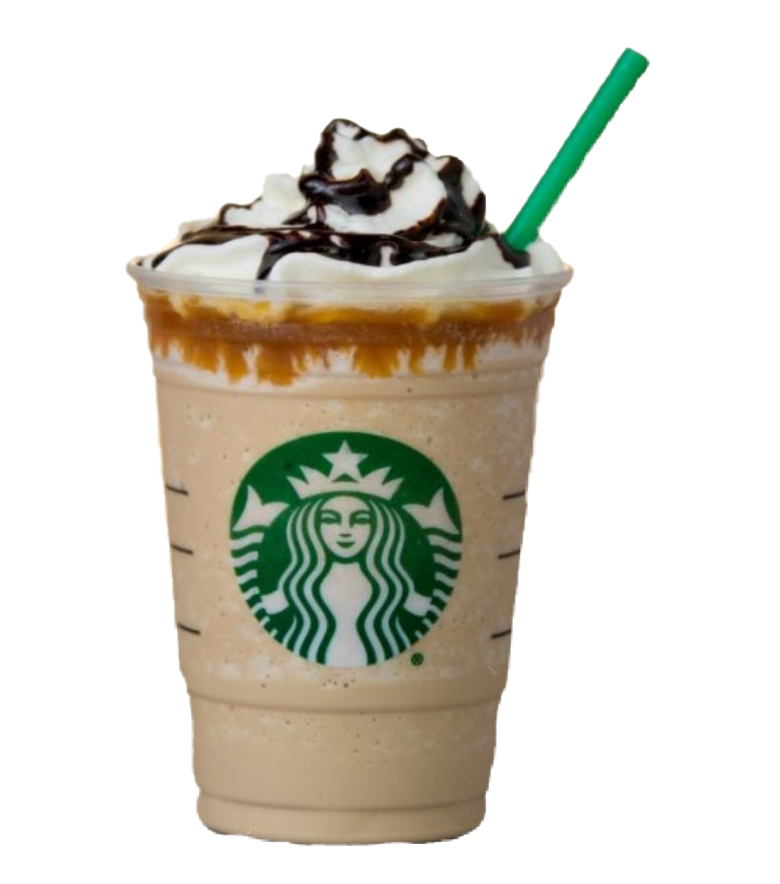
Starbucks
Starbucks Corporation is an American multinational chain of coffeehouses and roastery reserves headquartered in Seattle, Washington. It is the world's largest coffeehouse chain.

Slide 2
Coffee BEAN
Coffee bean Corporation is an American multinational chain of coffeehouses and roastery reserves headquartered in Seattle, Washington. It is the world's largest coffeehouse chain.

Slide 3
Tim HORTONS
Coffee bean Corporation is an American multinational chain of coffeehouses and roastery reserves headquartered in Seattle, Washington. It is the world's largest coffeehouse chain.

